Slide 1
Chapter - 13
SOCIAL GROUPS AND
SOCIAL CONTROL

Slide 2
Social Group
A social group is formed when two or more people who communicate to each other directly or indirectly and work together for some goals come together.
family, friends, clubs and organizations etc..

Slide 3
Observe the pictures and find out the differences between these social groups.

Slide 4
Picture 1
People may not know each other
There is no mutual interaction
Picture 2
now each other
There is mutual interaction

Slide 5
They are waiting for bus, staying at the same place without knowing and communicating to each other.
There may not be any specific kind of relationship between these people.
People gathered at an accident site and the audience in a theatre or stadium are such kind of groups.
These groups of people are called social aggregates.
They are also referred to quasi groups.

Slide 6
On the other hand family is a social group.
The features of family.
Small group
Familiar people
Elevated group consciousness
Common ways of acting
Satisfies the needs of the members
Influences personality

Slide 7
Many such social groups exist for satisfying the primary and other needs of individuals.

Slide 8
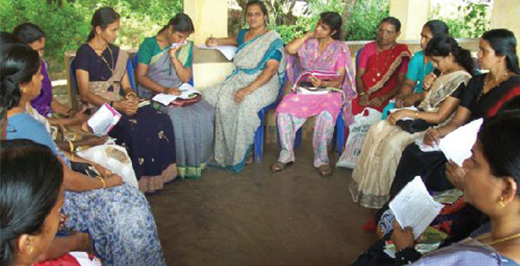
Try to find out the characteristic features of these social groups.

Slide 9
Picture 1
Picture 2
Same age of group (Peer group)
Informal relationship
Group to satisfy some special needs
Formal relationship

Slide 10
The first one is the group of people belonging to the same age (Peer group).
This is a group of people who know each other.
Members of a peer group have intimate relationship.
These groups do not have written rules or regulations.

Slide 11
Second Group
Clubs and voluntary service orgnisations are groups that work for some specific needs.
They work under a code of conduct.
There is formal relationship among the members of these groups

Slide 12
Social groups are classified on the basis of the strength of membership, mutual relationship among the members, ways of working and attempts to accomplish tasks
1. Primary group
2. Secondary group

Slide 13
Primary Group
Primary group is composed of a small group of people with intimate relationship, face-to-face interaction and mutual cooperation.
What are the characteristics of primary groups?
Members know each other.
Intimacy among the members.
Continuous communication among the members.
Welfare of members is the major aim.
Mutual cooperation among the members.

Slide 14
Identify and list out the primary groups that are close to your life.
Family

Slide 15
Secondary Group
secondary groups have more members than the primary of groups.
There is formal relationship among the members.
Secondary groups are formed to satisfy the common needs of the members.
At the same time, personal usefulness is the basis of membership in these groups.
Some secondary groups cease to exist once the objectives are satisfied.

Slide 16
Identify the secondary groups associated with your life.
Clubs
Football team

Slide 17
The influence and use of social groups in our life is significant.
Some of the uses are:
Promote companionship
Train behaviour patterns
Promote coexistence
Promote social values
Ensure cooperation

Slide 18
social groups imposing certain restrictions on the behaviour and thoughts of individuals.
Social pressure is exercised on individuals in everyday life through different ways.
Try to write down the behaviour patterns and habits you exhibit as a result of social pressure and control.
Dress in a particular way
Respect elders
Obey traffic rules

Slide 19
One cannot live according to one's own personal and selfish interests.
What will happen if each student in your class behaves as he likes?
What will be the situation of the family if each member of the family lives according to his/her own personal interests alone?
What will be the result, if the members of a football team play without obeying the rules of the game?

Slide 20
social control
If peace and happiness is to be sustained in society, all the members should obey the norms and laws formed by the society.
It is not possible to ensure social security without obeying the laws of the society.
The pressure and interventions exerted by each social group over its members in order to ensure and sustain a safe environment is called social control.

Slide 21
The features of social control.
In every society there are certain commonly accepted standards of behaviour.
Society establishes suitable social institutions for the regulation of behaviour and socialisation of its members.
Social control is formally implemented through the systems such as police, court, prison and military.
Society has institutions and systems to control, prevent or punish those who do not adhere to social control.

Slide 22
What will be the condition of society, if behaviours and habits of individuals are not regulated?
Members of the society may not be able to live in mutual agreement. Social security will be endangered. That is why society isolates, blames or punishes those who violate the norms and laws.

Slide 23
How is social control carried out?
Society adopts different methods and systems to systematise and control the behavioural patterns of its members.

Slide 24
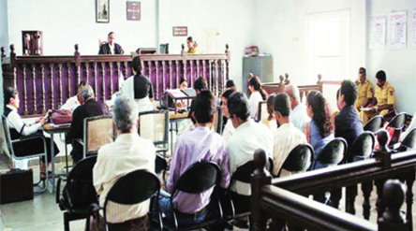
Traffic police try to prevent traffic violations on the road to ensure the safety and welfare of all commuters.
Police make the law breakers pay fine or produce them before the court. The convicted are sentenced after the trial in the court. Prison is the formal system established for implementing the sentence. Prison authorities implement the judgement of the court.
Children's homes and rehabilitation centers are the government systems established to bring back juveniles who commit crimes to the right path.

Slide 25
Social control is ensured not through conviction and punishment alone.
Society recognizes and respects those who achieve success through legally accepted ways.
Achievements are recognized in order to popularise the attempts considered as models.
All those mentioned above are the ways of formal social control.

Slide 26
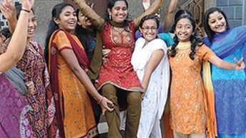
Observe these situations. Individuals are also appreciated informally when they make accomplishments in the matters that are socially recognized. Violation of norms may lead to verbal insults or blaming. These responses are effective informal ways of social control.

Slide 27
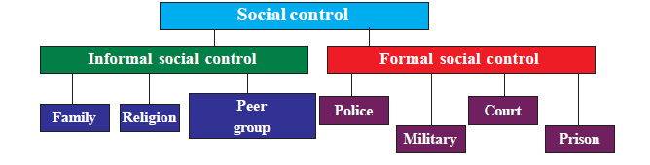
According to their common nature, means of social control can be classified into two categories.

Slide 28
Informal Social Control
These are not legally recorded ways of social control.
Customs, folkways, beliefs and traditions are the informal means of social control.
Violation of these will not lead to formal punishment.
Such people are disgraced, isolated or excommunicated from the society.
Informal social control is implemented through the primary social groups like family, religion and peer group.

Slide 29
Formal Social Control
What will happen if an individual violates a socially accepted law?
This individual will be punished through the systems like police, court and prison.
Civilised societies use these methods for social control.
These systems and institutions are established and implemented by the governments in each country.
These systems may vary according to time and societies.

Slide 30
Even though there are laws and punishment systems, some people violate them.
They do not follow socially accepted behavioural patterns.
Violation of the values, folkways, mores and laws that are accepted by the majority members of the society is called social deviance.
When social deviance takes place in large scales, it may lead to social disorganisation in such a way as to question the very existence of the society.

Slide 31
Perceptions of societies about social deviance may vary according to time and social circumstances.
Tribal communities considered hunting animals as a symbol of bravery. But now hunting animals is a crime.

Slide 32
Today, constitution, laws, education and official institutions have become unavoidable constituents of social control.

